Slide 1
Web Development Internship
- Amey Pathe

Slide 2

What is Web Development?
Web development is the process of creating websites and web applications that people can access over the internet.
It involves designing the look of the site (front-end), making sure it works well behind the scenes (back-end).
Key technologies used in web development include HTML, CSS, and JavaScript for the front-end, and languages like Python, Node.js, Php and databases like MySQL for the back-end.

Slide 3




Environment Setup
Integrated Development Environment (IDE)
Browser (Chrome, Edge, Brave)
Visual Studio Extensions (Live Server)
Version Control (Git)

Slide 4
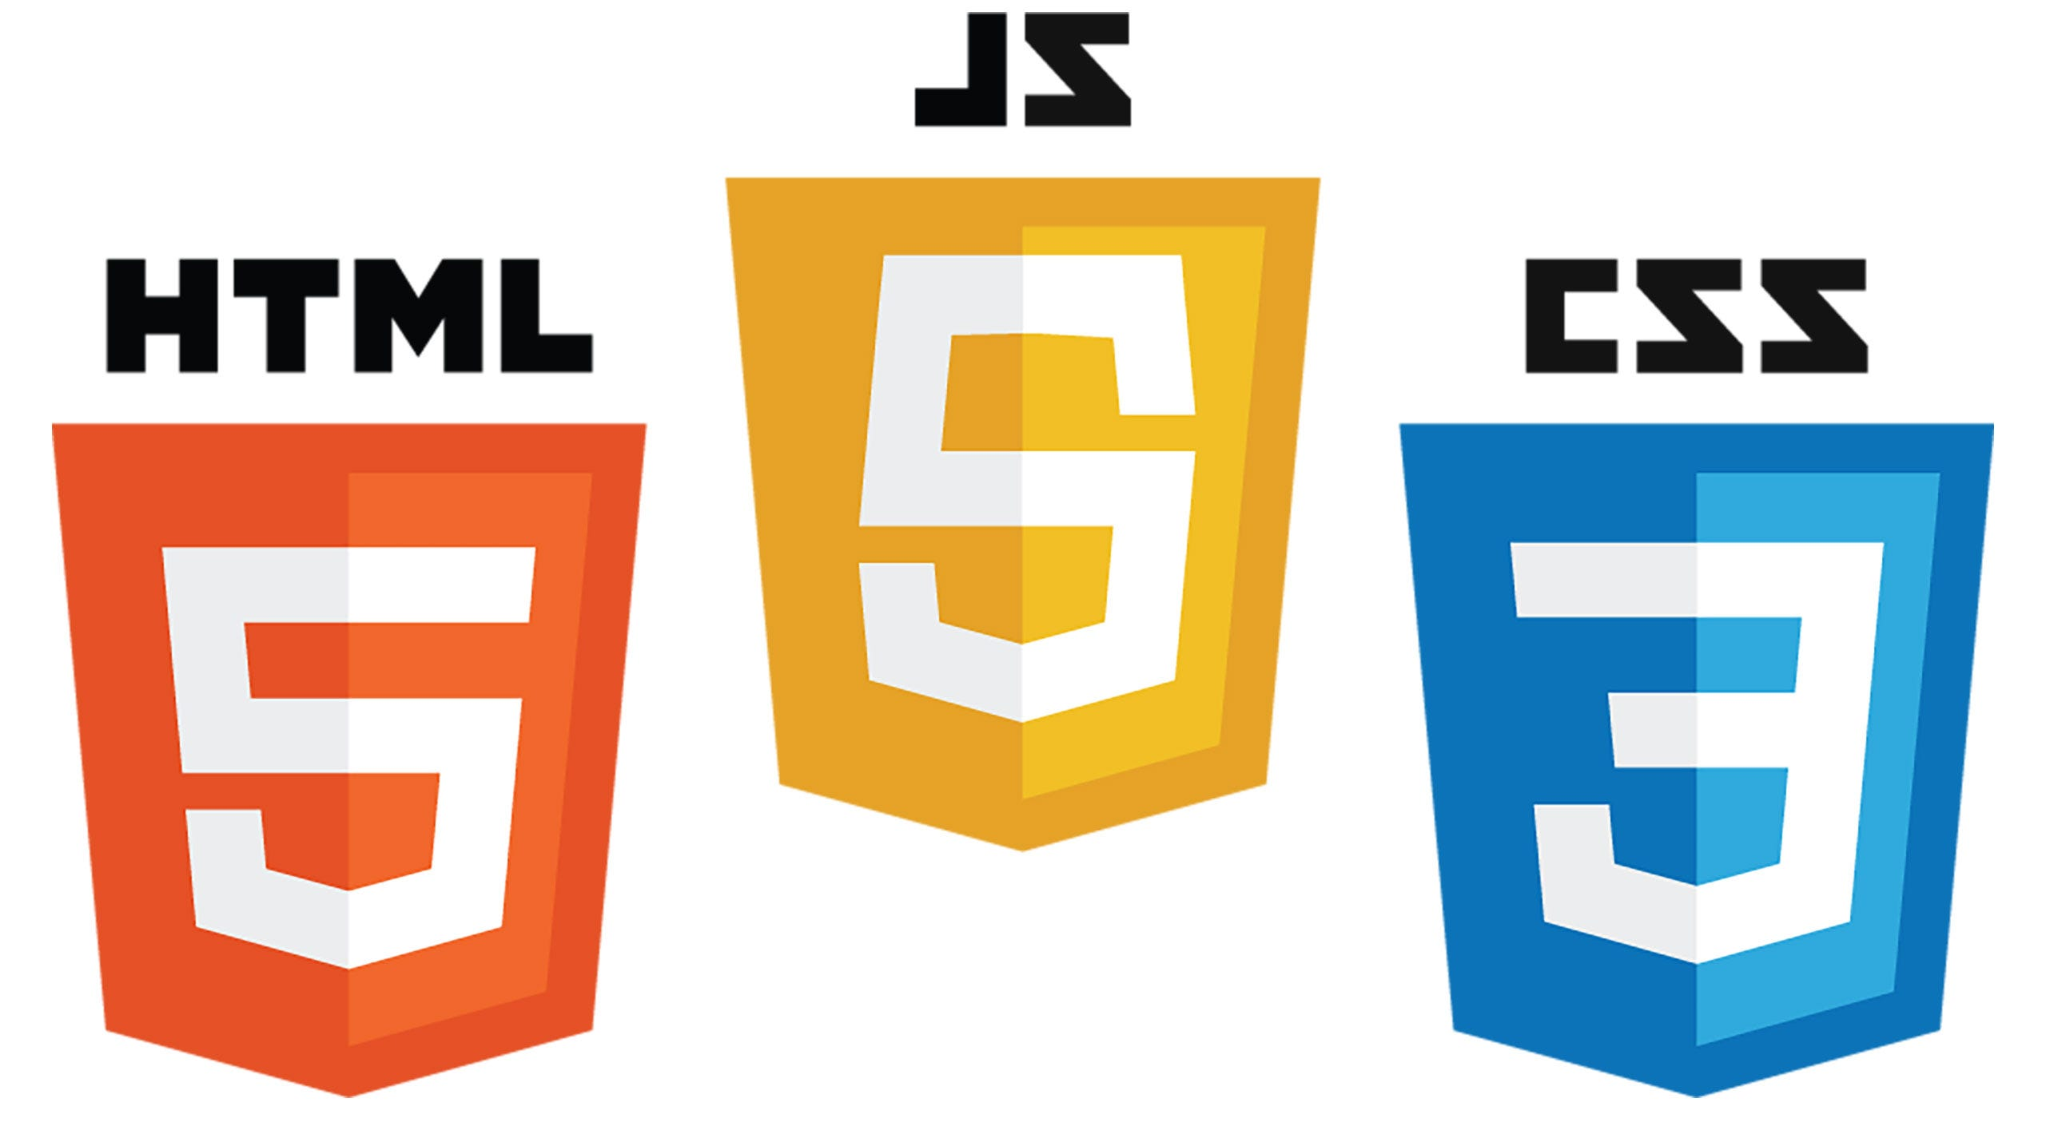






Frontend Vs Backend
Front-end development involves creating the part of the website that users interact with directly. This includes everything that users experience visually and interactively on their browser.
Back-end development involves creating the server-side part of a website. This includes the server, database, and application logic that power the front-end and handle data processing, storage, and retrieval.

Slide 5
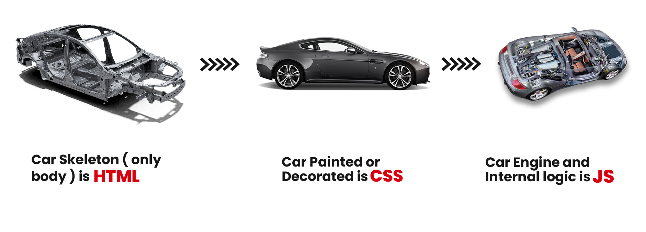
HTML, CSS & JS

Slide 6
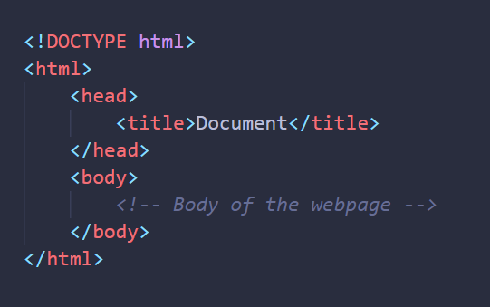
Structure of a HTML

Slide 7

Emmet in VS Code

Slide 8
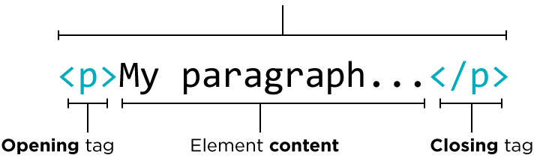
Tags in HTML
HTML tags are the basic building blocks of HTML, used to define and organize different parts of a web page.
Basic Structure: <!DOCTYPE html>, <html>, <head>, <title>, <body>
Content Sectioning: <header>, <nav>, <main>, <section>, <article>, <aside>, <footer>
Text Content: <h1>, <p>, <span>, <a>, <strong>, <em>, <br>, <hr>
HTML Element = Start Tag + Content + End Tag

Slide 9
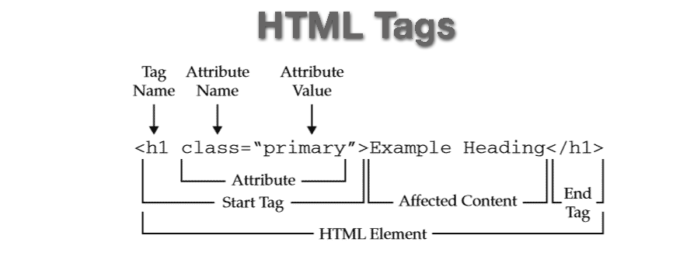
HTML Element

Slide 10
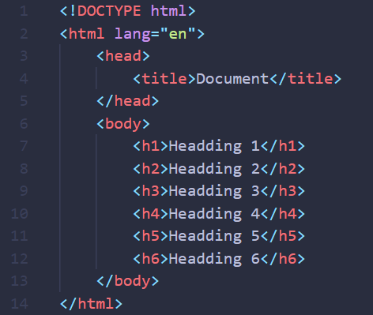
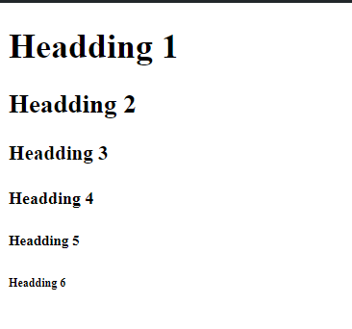
Heading Tags

Slide 11
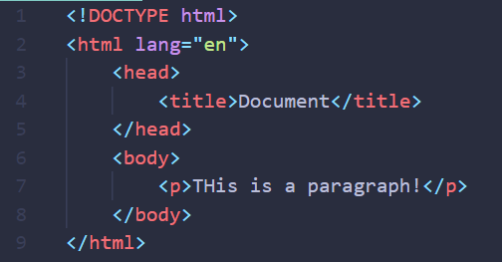
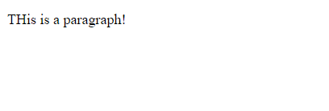
Paragraph Tag

Slide 12
Other Tags
Horizontal Line (hr tag)
Line Break (br)
Anchor Tag (a)
Image Tag (img)
preformatted text (pre)

Slide 13
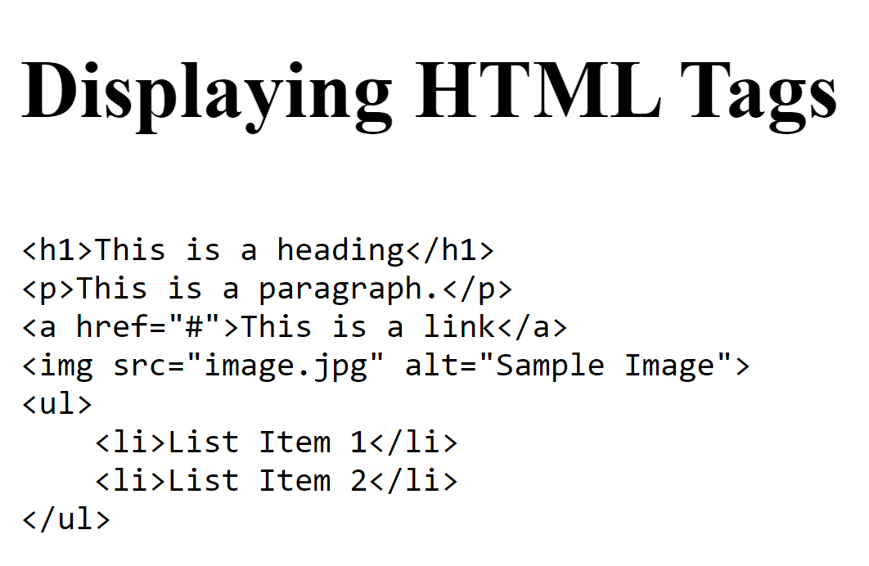
Task 1
Objective: Create a webpage that displays various HTML tags as text on the page

Slide 14
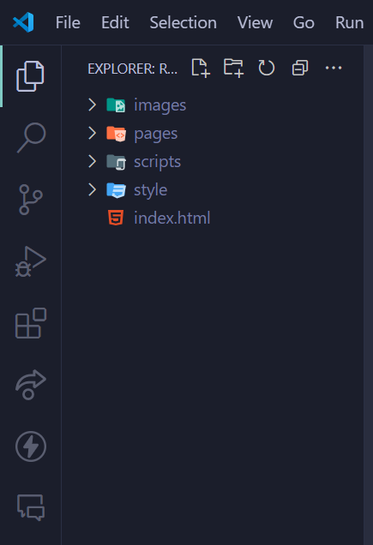
Managing Files in VS Code

Slide 15
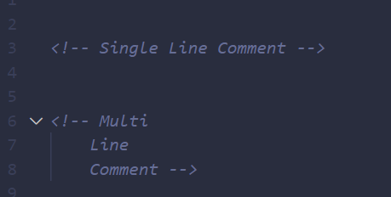
HTML Comments
Comments in HTML are used to leave notes or annotations within the code that are not displayed in the browser. They are helpful for developers to explain code, leave reminders, or temporarily disable parts of the code during development and debugging.

Slide 16
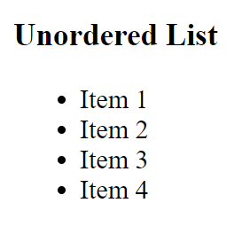
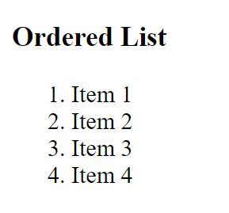
HTML Lists
Unordered List: Displays items using bullets.
Ordered List: Displays items in a numerical sequence, and supports various numbering styles like Arabic numerals, Roman numerals, and so on.

Slide 17
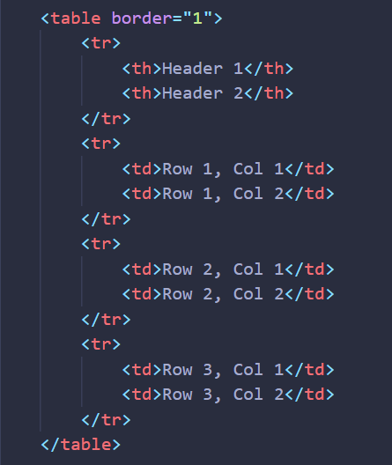
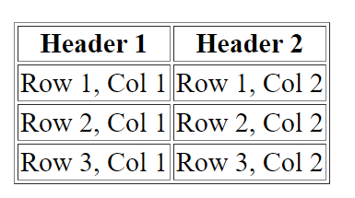
HTML Tables

Slide 18
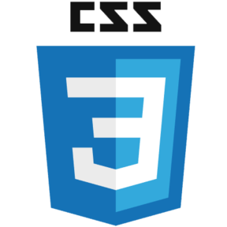
What is CSS?
CSS stands for Cascading Style Sheets. It is a stylesheet language that is used to describe the visual presentation of a web page written in HTML (Hypertext Markup Language).
HTML creates the structure of the page, while CSS adds styling to that structure.

Slide 19
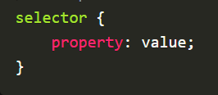
CSS Structure
CSS operates by selecting HTML elements and applying styles to them. Styles dictate the appearance of elements on a webpage. You can target HTML elements, classes, or IDs, defining properties like colors, fonts, margins, etc.

Slide 20
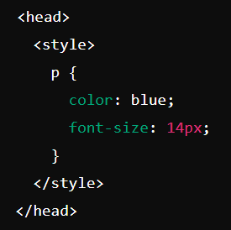
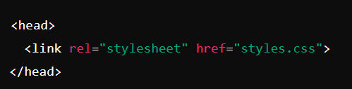
Types of CSS
Inline CSS: CSS is applied directly within the HTML element using the style attribute.
Internal CSS( a.k.a. Embedded CSS): CSS is defined within the <style> tag inside the <head> section of an HTML document.
External CSS: CSS is written in a separate .css file, which is linked to the HTML document using the <link> tag.

Slide 21
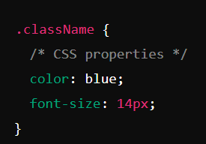
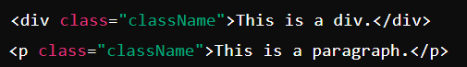
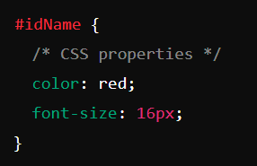
Classes and Id
Class: A class is a reusable style that can be applied to multiple elements. It is defined using a period (.) followed by the class name.
ID: An ID is a unique identifier for a single element. It is defined using a hash (#) followed by the ID name.

Slide 22
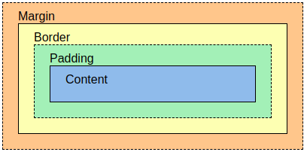
Box Model in CSS

Slide 23
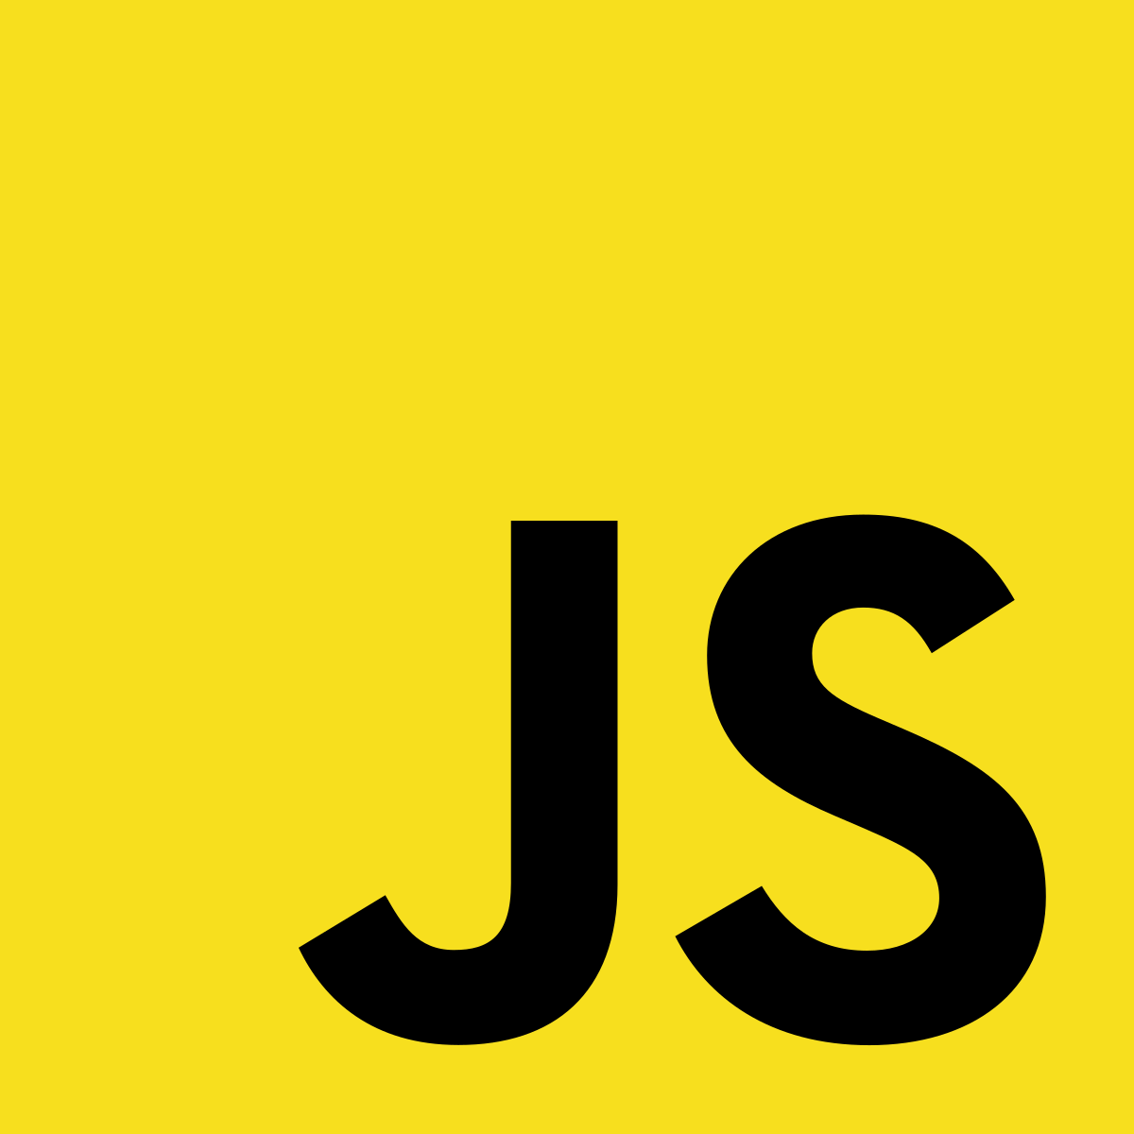
Introduction to Java Script
JavaScript is a client side scripting language.
Used for dynamic behavior, form validation, animations, and more.
Responds to user actions like clicks and keystrokes.
Essential for modern web development alongside HTML and CSS.
When JavaScript was created, it was initially called “LiveScript”.
JavaScript can execute not only in the browser, but also on the server.

